Slide 1
Accelerating Higher Education Expansion and Development (AHEAD) STEM Expansion and Human Resource Development (HRD) Result Area 1 and Result Area 2

Slide 2
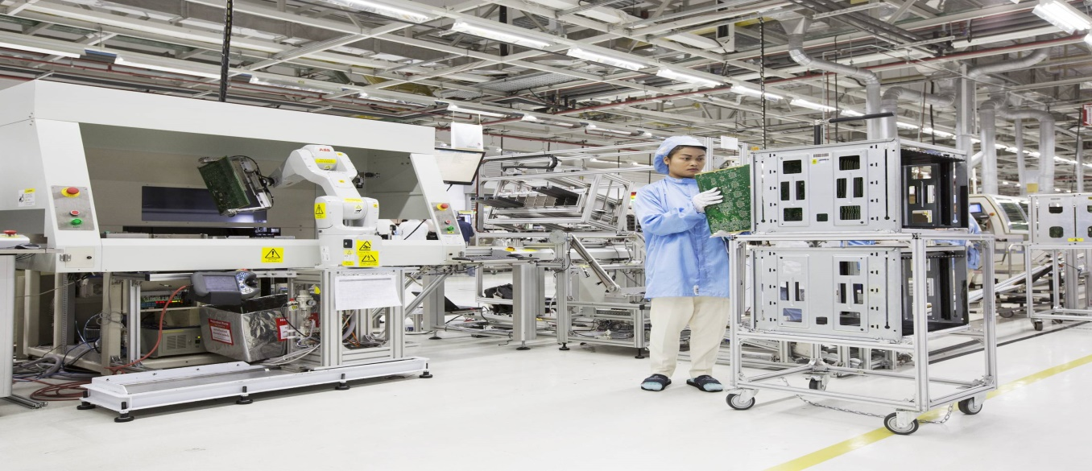
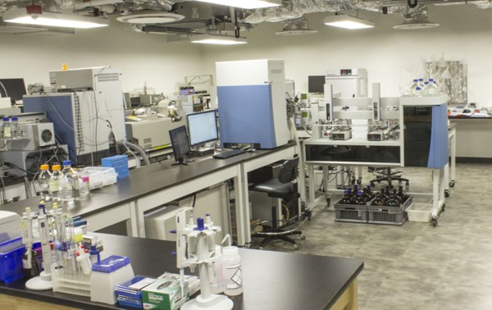
Result Area 1 : Increasing enrolment in higher Education in priority disciplines for economic development
2018 - Provide assistance for Technological, Engineering and Medical faculties to procure equipment (Excluding faculties where ADB funding is available)
Future assistance for equipment and construction /renovation available

Slide 3
Result Area 2: Improving the quality of Higher education
Human Resource Development (HRD) SCHOLARSHIP PROGRAMME FOR PhDs

Slide 4
Distribution of teaching staff in HEI according to education qualification and university 2016 data
University/HEI | 1st Degree including PGD | Master Degree | Mphil | MS/MD | Doctoral Degree | Doctoral qualification as a % of the total | Total
Colombo | 83 | 145 | 39 | 79 | 218 | 38.7 | 564
Peradeniya | 110 | 98 | 67 | 73 | 439 | 55.8 | 787
SJP | 71 | 154 | 37 | 61 | 234 | 42.0 | 557
Kelaniya | 54 | 137 | 61 | 62 | 229 | 42.2 | 543
Moratuwa | 61 | 74 | 27 | - | 187 | 53.6 | 349
Jaffna | 83 | 87 | 70 | 25 | 131 | 33.1 | 396
Ruhuna | 86 | 103 | 57 | 47 | 205 | 41.2 | 498
Open University | 60 | 97 | 42 | - | 110 | 35.6 | 309
Eastern | 54 | 45 | 50 | 10 | 54 | 25.4 | 213
S Eastern | 33 | 51 | 18 | - | 36 | 26.1 | 138
Rajarata | 55 | 70 | 29 | 15 | 51 | 23.2 | 220
Sabaragamuwa | 30 | 61 | 31 | - | 76 | 38.4 | 198
Wayamba | 37 | 39 | 17 | - | 65 | 41.1 | 158
Uva Wellassa | 42 | 34 | 11 | - | 37 | 29.8 | 124
Visual & PA | 13 | 50 | 29 | - | 15 | 14.0 | 107
All institures | 59 | 34 | 39 | 46 | 85 | 32.3 | 263
Total | 931 | 1279 | 624 | 418 | 2172 | 40.0 | 5424

Slide 5
Share of teaching staff with a doctoral Degree - 2016
Faculty/Academic stream | 100.0
Agriculture | 8.3
Architecture | 1.0
Arts and HSS | 18.3
Dental Science | 1.5
Education | 0.7
Engineering | 13.1
Indigenous Medicine | 3.0
Computer Sc./IT | 1.5
Law | 0.2
Management Studies | 7.0
Medicine | 20.3
Science | 23.0
Technology | 1.1
Vet. Medicine | 1.2

Slide 6
Distribution of teaching staff in HEI according to education qualification and age– (2016 data)
Qualification | Age group |  |  |  |  | Total
 | 21-30 | 31-40 | 41-50 | 51-60 | Above 60
Ph.D. | 1 | 370 | 797 | 705 | 236 | 2109
Other doctoral |  | 8 | 18 | 25 | 10 | 61
Total | 1 | 378 | 815 | 730 | 246 | 2170
Notes:
2 staff members birthdays are not mentioned
Only 17% are PhD qualified below 40 years of age. Out of the total staff, this is only 7%
It is also interesting to note that among the academic staff below 40 years of age only 21 percent have Ph.Ds

Slide 7
PROPOSED SCHOLARSHIP PROGRAMME FOR PhDs
Offered in collaboration with the UGC and NCAS scholarship schemes
Allocations made on an equitable basis
Ensures gender equity
Expected to be done in English medium (unless under exceptional circumstances) and on full time leave
Funding - up to 3 years to support
- Full – time PhD programs in overseas universities
- Full time Split-Site PhD programs

Slide 8
PROPOSED SCHOLARSHIP PROGRAMME FOR PhDs (Cont.)
Candidates expected to register in a University other than which they are employed in (exceptions granted under special circumstances)
Universities/candidates are;
Strongly encourage prospective candidates to use existing agreements (MOUs) with foreign universities (arrived by Faculties/Universities or UGC) in selecting PhD opportunities.
Encouraged to explore the possibilities of scholarships in good countries/universities where the registration/course fee as well as cost of living is low.

Slide 10
DISTRIBUTION OF ALLOCATIONS
Grants will be made available in four rounds, as two rounds each in years 2018 and 2019.
STEMS | HEMS including Law and Education
35% | 65%
Notes:
AHED - The allocations have been made to universities and undergraduate institutes on an equitable basis.
HETC – Favours the arts and social sciences and North and east and new universities
World University Rankings 2015-2016
The Times Higher Education World University Rankings 2015-2016 list the best global universities and are the only international university performance tables to judge world class universities across all of their core missions - teaching, research, knowledge transfer and international outlook

Slide 11
FUNDING ALLOCATIONS
Maximum allocation of LKR. 9 million per candidate, depending on factors such;
whether full or split site program
living cost of the country
registration/course fee of the program, etc.
Grant winners will receive
Program registration fees
cost of living allowances/monthly allowance for the time period the candidate will be studying abroad
Any other research expenses incurred

Slide 12
ELIGIBILITY
Probationary Lecturers, Lecturers and Senior Lecturers of Universities, Campuses and Undergraduate Institutes without PhD qualifications, subject to the following eligibility criteria:
The Candidate should be less than 40 years of age
The Candidate should be a permanent member of the academic staff
The Candidate should be entitled for full time leave for the entire period of PhD
The Candidate should have obtained IELTS minimum score 7.0 or equivalent at the time of commencement of training
The Candidate should fulfill the eligibility requirement of the Trainer University

Slide 13
SELECTION PROCESS

Slide 14
Call for applications by UGC
Selection of suitable applicants by a panel appointed by the UGC
Identify reserve candidates
Collecting relevant documents and Candidate securing placement/Register
No placement within 6 months
Award of Scholarships
Issuance of official letter
Appeal
Offer letter+Bond+Leave+Budget to OMST
Progress monitoring by the OTS and OMST
Release of grants to respective home university OTS offices
Release of installments by the university /OTS

Slide 15
Thank you

